Slide 1
ADA AJUNWA
GOOGLE PLAY STORE APP DOWNLOAD INFLUENCES
SPRINGBOARD CAPSTONE PROJECT

Slide 2
OVERVIEW
The problem is to ascertain the impact of variables such as minimum required android version, price, size, ratings, as well as any other significantly impacting variables on the marketability (number of downloads) of an android mobile application. My prospective clients would be mobile application development companies. It is believed that an understanding of the significant factors that influence the marketability of a mobile application, would aid designers and developers in making informed decisions during application implementation and deployment..

Slide 3
OVERVIEW CONTINUES
Based on data analysis, the effect of mobile application build and pricing on its marketability would be determined. The important fields contained in the data set are Rating, Pricing, Size, Reviews, Category, AndroidVer (minimum required version), LastUpdate (date of last update), and Installs. It would have been nice to have the creation date for each observation, as this would have aided in determining if there was a significant relationship between creation date and number of installs.

Slide 4
THE Data
The data holds various exciting build and social information on android mobile applications.
The data was scraped from Google Play Store It can be used for both exploratory data analysis (EDA) and predicting how marketable an android mobile app is.
The initial dataset had 10841 Observations and 12 variables. After data wrangling, we ended up with 10840 observations and 19 Variables

Slide 5
Data dictionary
App – App name (unique nominal)
Category – App category (nominal: "ART_AND_DESIGN”, “FAMILY”, “SOCIAL”, etc.)
Rating – App rating (numeric: from 1 to 5)
Reviews – Number of reviews (numeric: from 0 to 78158306)
Size – Size of app (nominal: "1.0M","1.1M”, etc.)
Installs – Number of downloads (Ordinal: 0, 1, 5, 10, 50, 100, 500, 1000, 5000, 10000, 50000, 100000, 500000, 1000000, 5000000, 10000000, 50000000, 100000000, 500000000, 1000000000)
Type – Type of payment (Binary "Free", "Paid")
Price – Cost of app (numeric: from 0 – 400)
ContentRating - Type of audience app was designed for ("Adults only 18+", “Everyone”, “Teen”, etc.)
Genres - Genre of App (nominal: "Action", "Action; Action & Adventure", etc.)

Slide 6
Data dictionary (continues)
LastUpdated – Last date an update was made to the app (character: "1-Apr-16","1-Apr-17", etc.)
AndroidVer – Minimum operating system version required for installation (nominal: "1.0 and up","1.5 and up", etc.)
SizeKB – App size in kb (numeric: 8.5 - 100000)
AdjustedInstall2 - Number of downloads levels (ordinal: 1, 2, 3)
AdjustedInstall - Number of downloads levels (nominal: "Extremely Small", “very small”, “small”, medium”, large”, “very large”)
Day - Last day an update was made to the app (numeric: 1 – 31)
Month - Last month an update was made to the app (norminal: “Jan”, “Feb”, “Mar”, etc.)
Year - Last year an update was made to the app (numeric: 10 – 18)
MinimumVer – Cleaned minimum operating system version required for app installation (nominal: "Version 1s","Version 2s", etc)

Slide 7
Target/ dependent Variable
There were 20 download levels for the Installs variable ("0", "1", "5", "10", "50", "100", "500", "1000", "5000", "10000", "50000", "100000", "500000", "1000000", "5000000", "10000000", "50000000", "100000000", "500000000", "1000000000“)
The Installs variable where compressed into the final target variable (AdjustedInstall2), with small downloads level 1 (0 – 500), medium downloads level 2 (1000 – 1000000), and large downloads level 3 (5000000 – 1000000000)

Slide 8
TESTING CORRELATION
A test of the 4 numeric independent variables showed no correlation between the variables Reviews, Rating, Price, and SizeKB
Reviews Rating Price SizeKB
Reviews 1.000000000 0.06801795 -0.009667264 0.12825591
Rating 0.068017953 1.00000000 -0.020189657 0.07486182
Price -0.009667264 -0.02018966 1.000000000 -0.02299309
SizeKB 0.128255915 0.07486182 -0.022993092 1.00000000

Slide 9
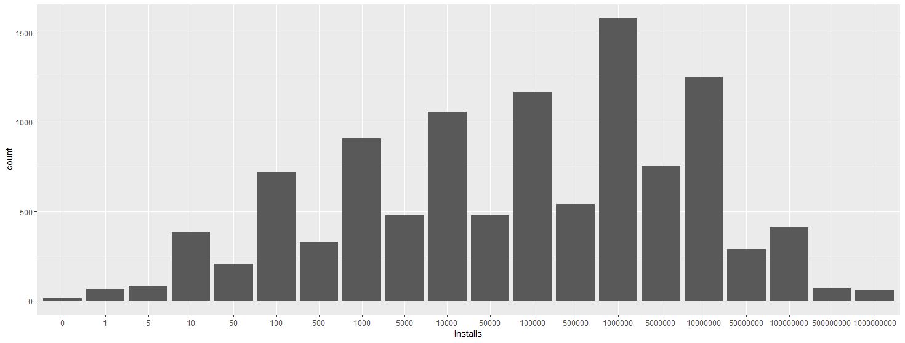
Exploratory data analysis
An outlier of 19 was found in the Rating variable and removed
Most apps had downloads of 1,000,000 and above with an average number of downloads of 15,464,339

Slide 10
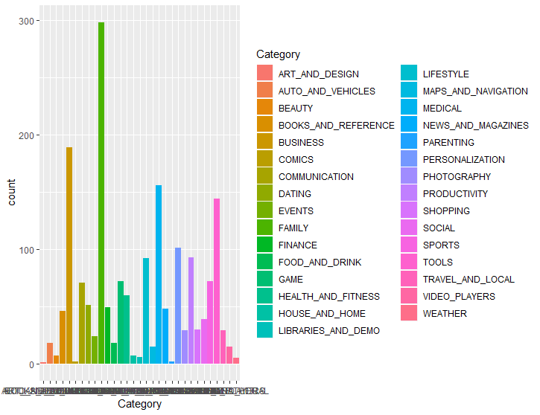
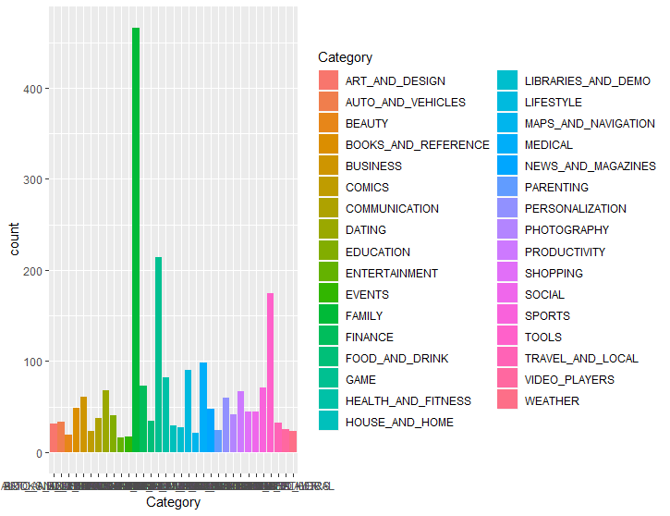
Exploratory data analysis (continued)
Extremely to very small downloads (1-10000. Largest presence are Family, Tool and Medical apps.
Small to medium downloads (50000-500000). Largest presence are Family, Gaming and Tool apps.

Slide 11
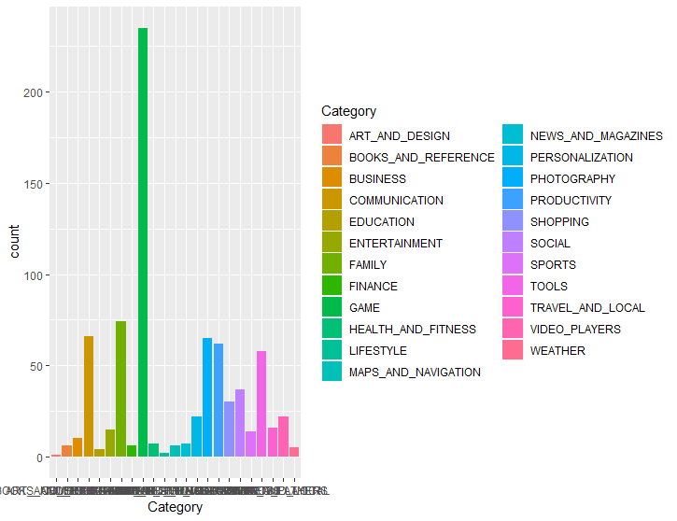
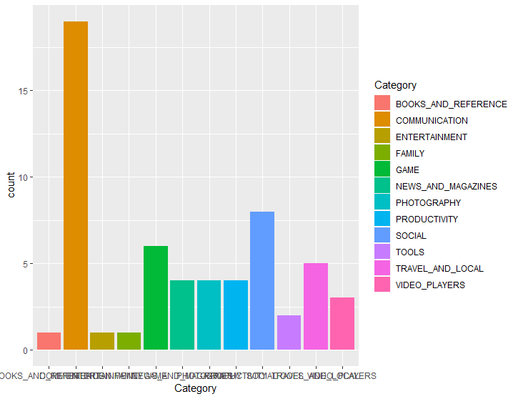
Exploratory data analysis (continued)
Large downloads (50000000-500000000). Largest presence are Gaming, Family and Communication apps.
Very large downloads (1000000000+). Largest presence are Communication, Social and Gaming apps.

Slide 12
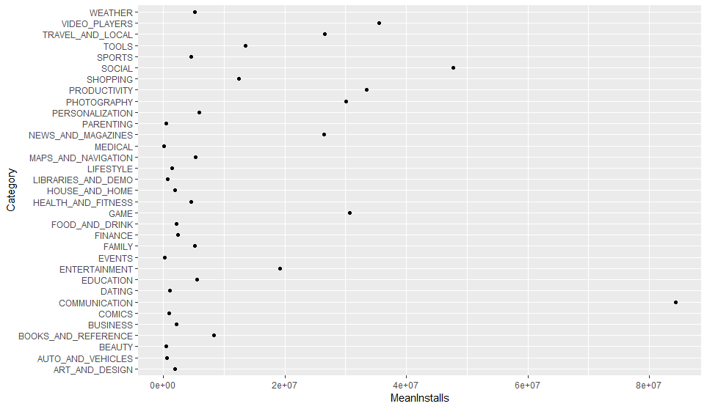
Exploratory data analysis (continued)
Overall the communication apps have the highest average downloads, followed by Social apps, then Video Player apps.

Slide 13
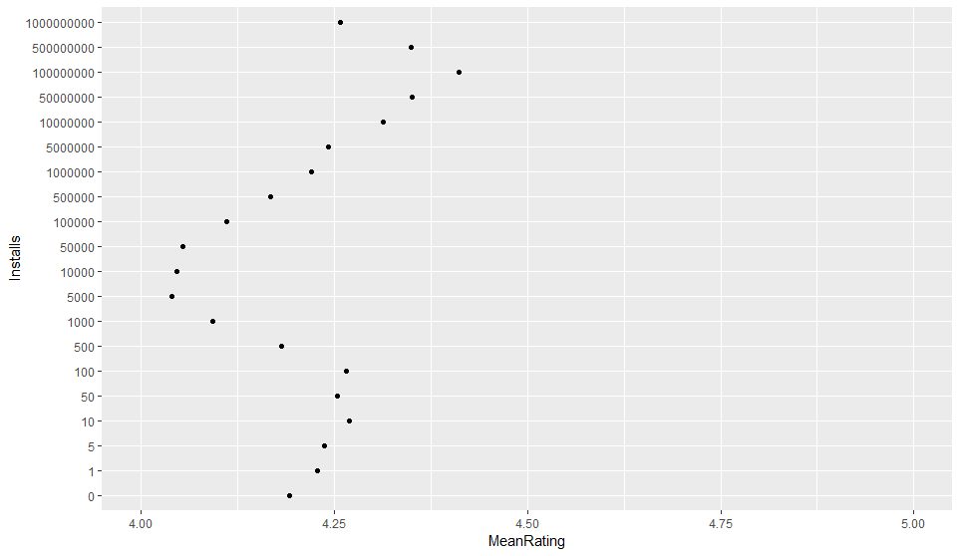
Exploratory data analysis (continued)
Apps with downloads fewer than 5000 are negatively affected by ratings.
Apps with downloads between (5000 - 100,000,000) are positively affected by ratings.
Apps with downloads 100,000,000 and above are negatively affected by ratings.

Slide 14
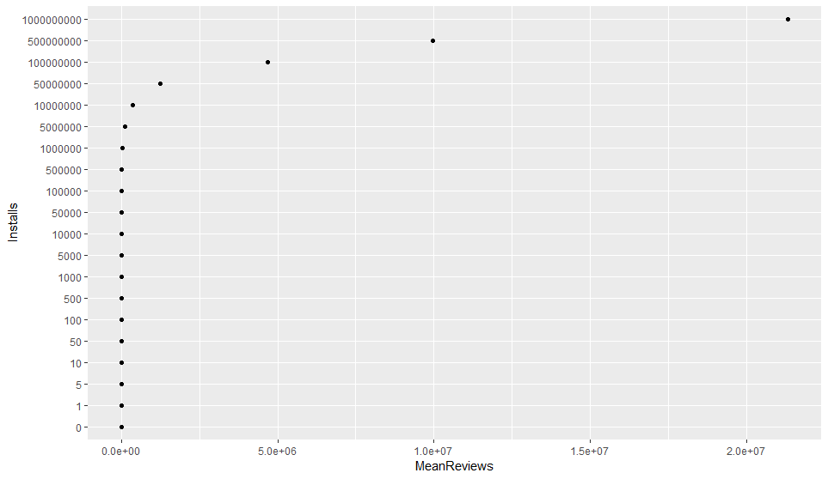
Exploratory data analysis (continued)
Number of reviews has a strong positive impact on number of downloads
Installs MeanReviews
0 0.000000e+00
1 2.985075e-01
5 5.365854e-01
10 1.085492e+00
50 2.370732e+00
100 5.432545e+00
500 1.231818e+01
1000 3.844432e+01
5000 1.009015e+02
10000 3.439791e+02
50000 9.863194e+02
100000 3.388369e+03
500000 9.798670e+03
1000000 3.303677e+04
5000000 1.028015e+05
10000000 3.625296e+05
50000000 1.232242e+06
100000000 4.671250e+06
500000000 9.957384e+06
1000000000 2.133618e+07

Slide 15
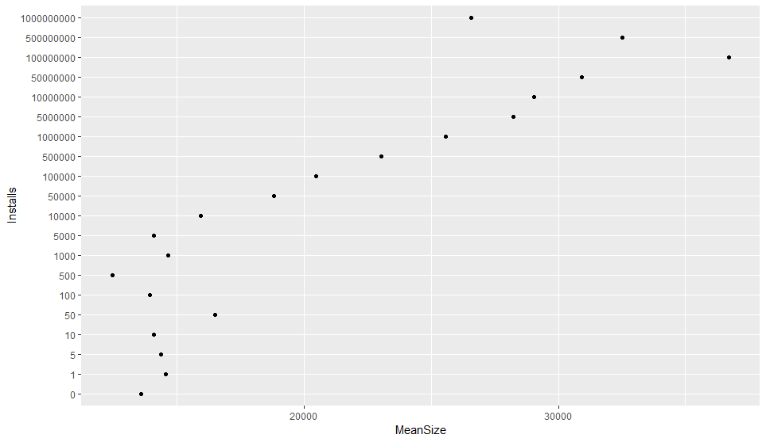
Exploratory data analysis (continued)
Mobile app size seems to have a positive influence on number of downloads

Slide 16
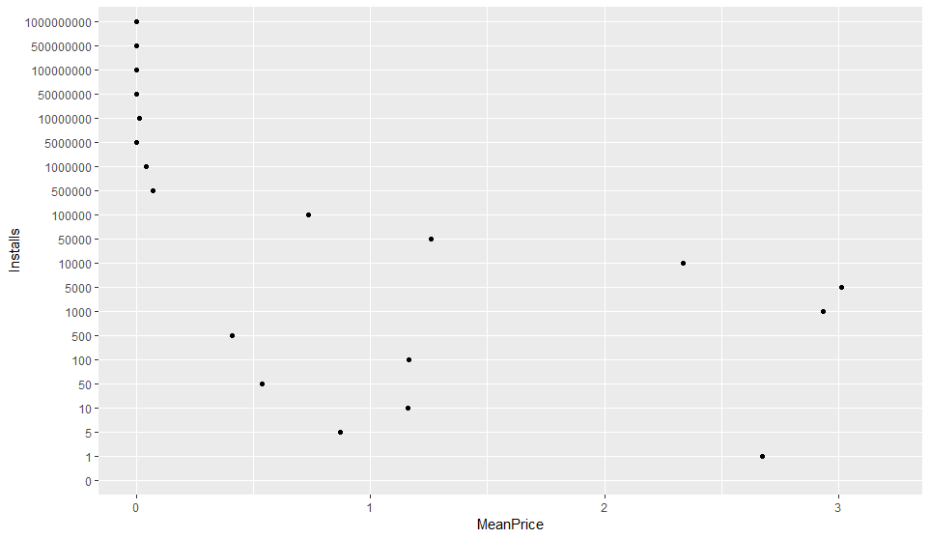
Exploratory data analysis (continued)
Price negatively affects number of downloads

Slide 17
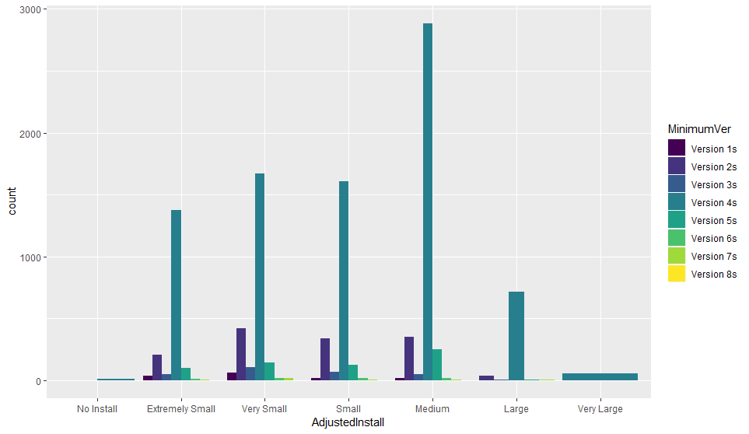
Exploratory data analysis (continued)
Apps that can only be downloaded with android phones using a minimum OS version of 4 were the most downloaded

Slide 18
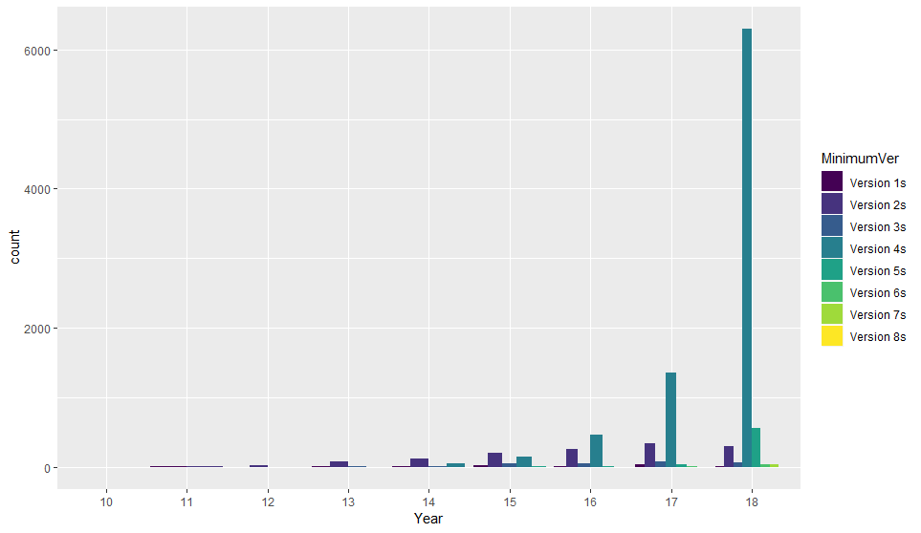
Exploratory data analysis (continued)
Phones with newer android versions can download more Google Play Store apps

Slide 19
Exploratory data analysis (continued)
The top performing app categories (99 percentile or more in Reviews, Rating and number of Installs) are Gaming apps, Communication apps, Family apps and Social apps
CATEGORY n
GAME 43
COMMUNICATION 25
FAMILY 10
SOCIAL 10

Slide 20
Model Considerations
A supervised classification machine learning problem.
Outcome variable is ordinal, thus, ordinal logistic regression or decision tree method would be best suited for the problem.
The decision tree method was finally picked, because the ordinal logistic regression model has issues with the Reviews variable.
The model without Reviews variable gave an accuracy of 72%, while the model with the Reviews variable included gave an accuracy of 88.9%
treepredict1 = predict(tree, newdata = testing, type="class")
t1<- table(testing$AdjustedInstall2, treepredict1)
sum(diag(t1))/sum(t1)

Slide 21
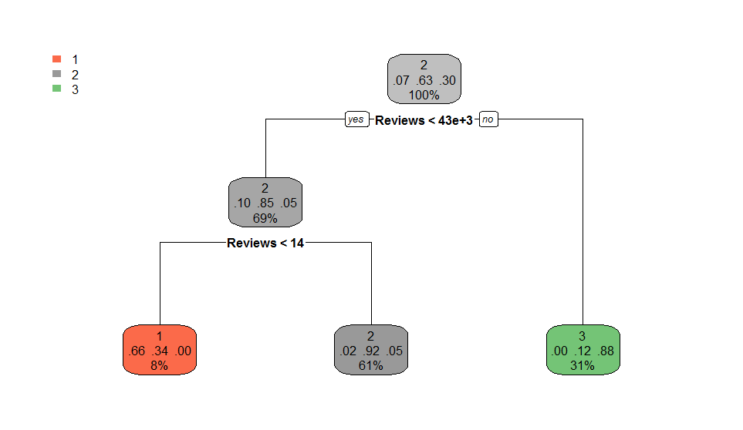
Regression tree
The independent variables were Rating, Reviews, Price, SizeKB, and MinimumVer, and the outcome variable is AdjustedInstall2
The tree split across the Reviews variable for each download level.

Slide 22
CROSS VALIDATION
When a 10 fold times 3 cross validation method was applied on the regression tree, the testing set accuracy increased to 90.75%
tcontrol<-trainControl(method="repeatedcv", number=10, repeats=3, search="grid")
tunegrid<-expand.grid(eta=c(0.05,0.075,0.1),nrounds=c(50,75,100), max_depth=6:8,min_child_weight=c(2.0,2.25,2.5),colsample_bytree = c(0.3,0.4,0.5),gamma=0, subsample=1)
traincv<-train(AdjustedInstall2 ~ ., data = training, method ="xgbTree",tuneGrid=tunegrid, trcontrol= tcontrol)
preds<- predict(traincv, testing)
Confusion Matrix and Statistics
Reference
Prediction 1 2 3
1 122 24 0
2 72 1661 83
3 0 81 767
Overall Statistics
Accuracy : 0.9075
95% CI : (0.8962, 0.9179)
No Information Rate : 0.6285
P-Value [Acc > NIR] : < 2.2e-16
Kappa : 0.8146
Mcnemar's Test P-Value : NA
Statistics by Class:
Class: 1 Class: 2 Class: 3
Sensitivity 0.62887 0.9405 0.9024
Specificity 0.99083 0.8515 0.9587
Pos Pred Value 0.83562 0.9146 0.9045
Neg Pred Value 0.97297 0.8944 0.9577
Prevalence 0.06904 0.6285 0.3025
Detection Rate 0.04342 0.5911 0.2730
Detection Prevalence 0.05196 0.6463 0.3018
Balanced Accuracy 0.80985 0.8960 0.9305

Slide 23
Random Forest model
A final random forest model of all 5 independent variables increased the predictive accuracy to 91.28%
Variable influences according to importance were Reviews, SizeKB, Rating, MinimumVer, and Price respectively
Random Tree Confusion Matrix
predictrandom
1 2 3
1 137 57 0
2 39 1648 79
3 0 70 780
Independent Variable Order Of Importance
MeanDecreaseGini
Reviews 2336.86128
SizeKB 367.26198
Rating 334.54551
MinimumVer 62.90261
Price 53.80918

Slide 24
Summary
The variables Rating, Reviews, Price, SizeKB, and MinimumVer were very significant in predicting number of downloads
After sampling 3 different models (1 ordinal logistic regression model, and 2 regression tree models), the second regression tree model which included Rating, Reviews, Price, SizeKB, and MinimumVer, was the best as it gave an accuracy of 88.9%
The model was however improved after applying cross validation, as it gave a predictive accuracy of 90.75%
The final model was a random forest model consisting of all 5 independent variables. This gave the best predictive accuracy of 91.28.
The top 3 influences of number of downloads in order of importance are number of reviews, size of app, and app rating

Slide 25
REFERENCE
https://www.kaggle.com/lava18/google-play-store-apps

Slide 26
THE END

